Slide 1





Rungta College of Engineering and Technology(Bhilai)
This presentation will highlight the development of the HousePricePrediction System, a project guided by Professor Deepak Pandey at Rungta College of Engineering and Technology.
by Vivek Kumar

Slide 2
HousePricePrediction System
Project Overview
Key Objectives
Practical Applications
Our team built a machine learning model to predict house prices based on various features.ba
Accurate price forecasting, identifying key price drivers, and providing insights for buyers and sellers.
Real estate investments, market analysis, and personalized price estimates for homeowners.
( avg income, House age , Number of rooms, number of bedrooms ,area population)

Slide 3

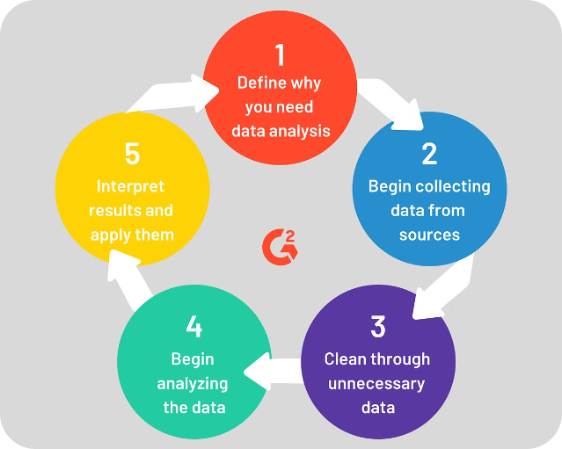
Introduction to the Project
1
Problem Statement
Accurately predict house prices based on various attributes like ( avg income, House age , Number of rooms, number of bedrooms ,area population) etc.
2
Significance
Empowers real estate decisions, identifies market trends, and benefits buyers/sellers.
3
Motivation
Meet the growing need for reliable and data-driven home valuation tools.

Slide 4


Project Objectives
Accurate Prediction
Develop a robust model to forecast house prices with high accuracy.
Identify Price Drivers
Analyze relevant features that significantly impact home valuations.
Actionable Insights
Provide meaningful data-backed recommendations for buyers, sellers, and investors.

Slide 5






Libraries and Technologies Used
Python
Primary programming language for model development and data analysis.
Pandas
Data manipulation and analysis library for handling structured data.
Scikit-learn
Machine learning library for model training, evaluation, and deployment.
Matplotlib
Visualization library for creating informative and visually appealing plots.

Slide 6
Model Development and Training
Data Collection
1
Gather relevant house price data from various sources.
2
Data Preprocessing
Clean, transform, and engineer features to prepare the dataset.
Model Selection
3
Evaluate and choose the most suitable machine learning algorithm.
4
Model Training
Train the model using the prepared dataset and hyperparameter tuning.
Model Evaluation
5
Assess the model's performance using relevant metrics like R-squared, RMSE.

Slide 7




Conclusion and Future Scope
Conclusion
Key Achievements
Future Scope
The HousePricePrediction System successfully forecasts house prices with high accuracy.
Identified crucial price drivers, provided actionable insights, and demonstrated practical applications.
Explore advanced techniques, expand the dataset, and integrate with real estate platforms.

